Slide 1
Nuclencrypter
Digital Signatures for Encryption to Facilitate Safe Data Storage
Angela Yang, Amanda Xu, Sunny Li

Slide 2
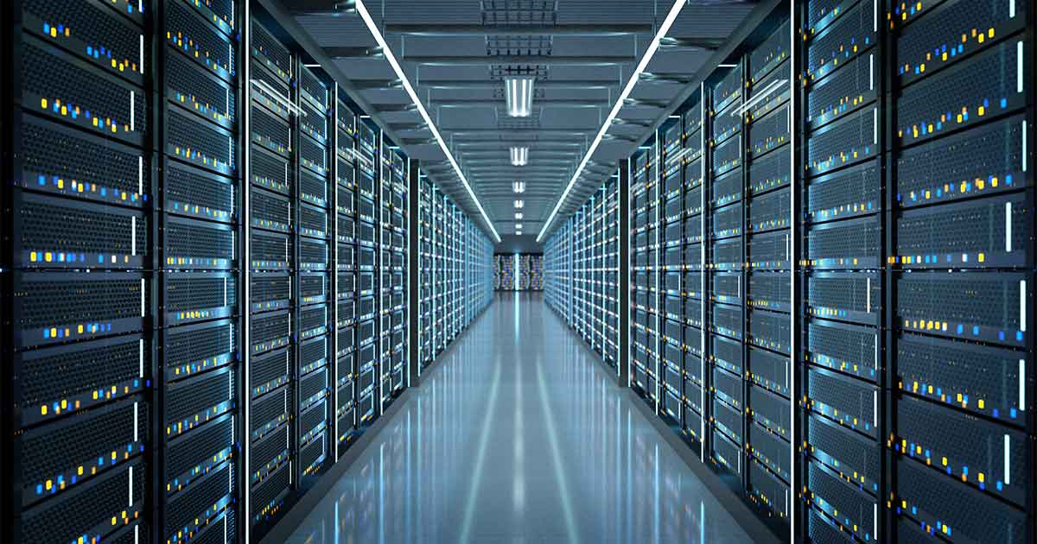
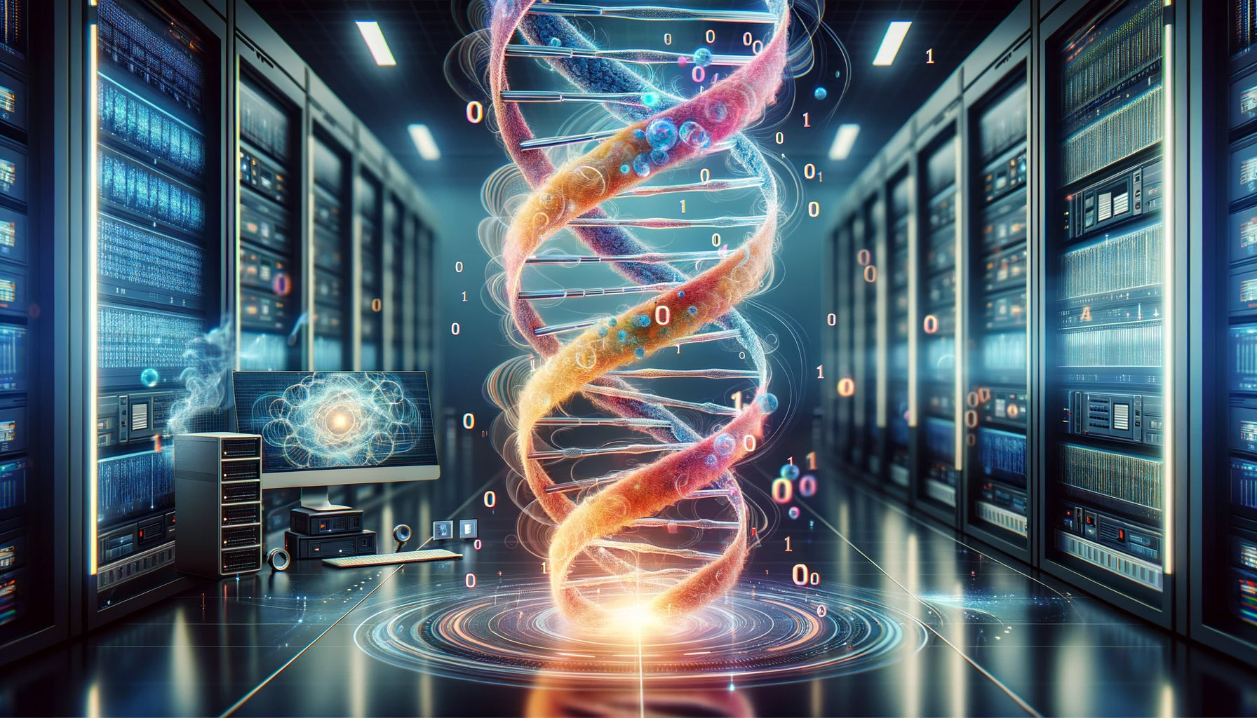
Introduction
By 2020, there are 64 Zettabytes (64 * 1e12 GB) of digital data in the world.
The biological information storage system is extremely efficient
Around 6 feet of DNA is compressed in a singular cell.
All the DNA in a human body, stretched out, is twice the diameter of the solar system
DNA is at least 1000-fold more dense than the most compact solid-state hard drive & at least 300-fold more durable than the most stable magnetic tapes
What if we store data in the forms of DNA?

Slide 3
Introduction
Hello_World!
Goal: Safeguard personal information that requires password protection
Encryption
-- Convert messages into DNA sequences
-- Generate specific key for user
Storage
-- Create synthetic DNA molecule / digital DNA model
Decryption
-- User enter key
-- Convert DNA sequences back to messages
Encrypt
Decrypt
GGGCTAGCTTTCCGCTTGGGTGGCGGCCCCCCCTTTGGGGAACA
Synthesize
Sequence

Slide 4
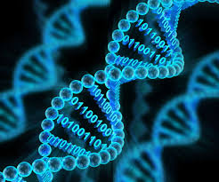
Data
In this project:
Phone number (xxx)xxx-xxxx
Address lines
Replacing spaces “ “ with underscores “_”
3400_Charles_St,_Baltimore,_MD_21218
Short paragraphs (about 20-30 words)
In real life: more extensive data
Multimedia (images, audio files), spatial data (geographic coordinates, maps), identifiers (government IDs), etc.

Slide 5
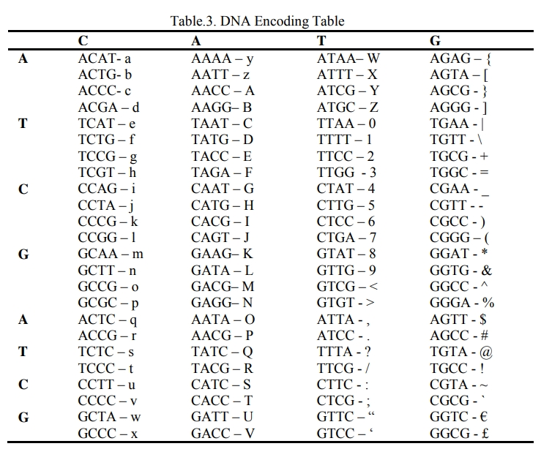
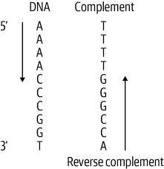
Methods: Encryption
1. Encoding to DNA
2. Reverse Complement
3. Right Shift
ACCAGGGCTTTT
↓
TACCAGGGCTTT
Padmapriya, M.K., and Vinitha, P. A Technique of Data
Security using DNA Cryptography with Optimized Data
Storage. Journal of System and Management Sciences.

Slide 6
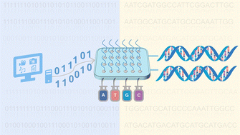
Methods: Encryption
4. Segmenting and Permuting
TACCAGGGCTTT
↓
TAC CAG GGC TTT
↓
CAG TTT TAC GGC
↓
CAGTTTTACGGC
Divide sequence into 4 parts
Rearrange parts based on a randomized permutation pattern (e.g. [2, 4, 1, 3])
Permutation pattern used: key given to the customer (eg.[2, 4, 1, 3]
Next Step: DNA Synthesis & Storage
Padmapriya, M.K., and Vinitha, P. A Technique of Data
Security using DNA Cryptography with Optimized Data
Storage. Journal of System and Management Sciences.

Slide 7
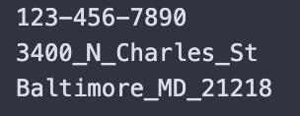
Methods: Encryption
Given to customer
Encryption Result: Encrypted Messages(DNA) + key
CAGTTTTACGGC
[2, 4, 1, 3]
input file:
1 message per line
output file:

Slide 8
Sequence → Decrypt
How to restore original messages when there are sequencing errors?
Notes:
To dcrypt messages, we need to sequence synthesized DNA. A Key question here: how do we restore original messages even when there are sequencing error.

Slide 9
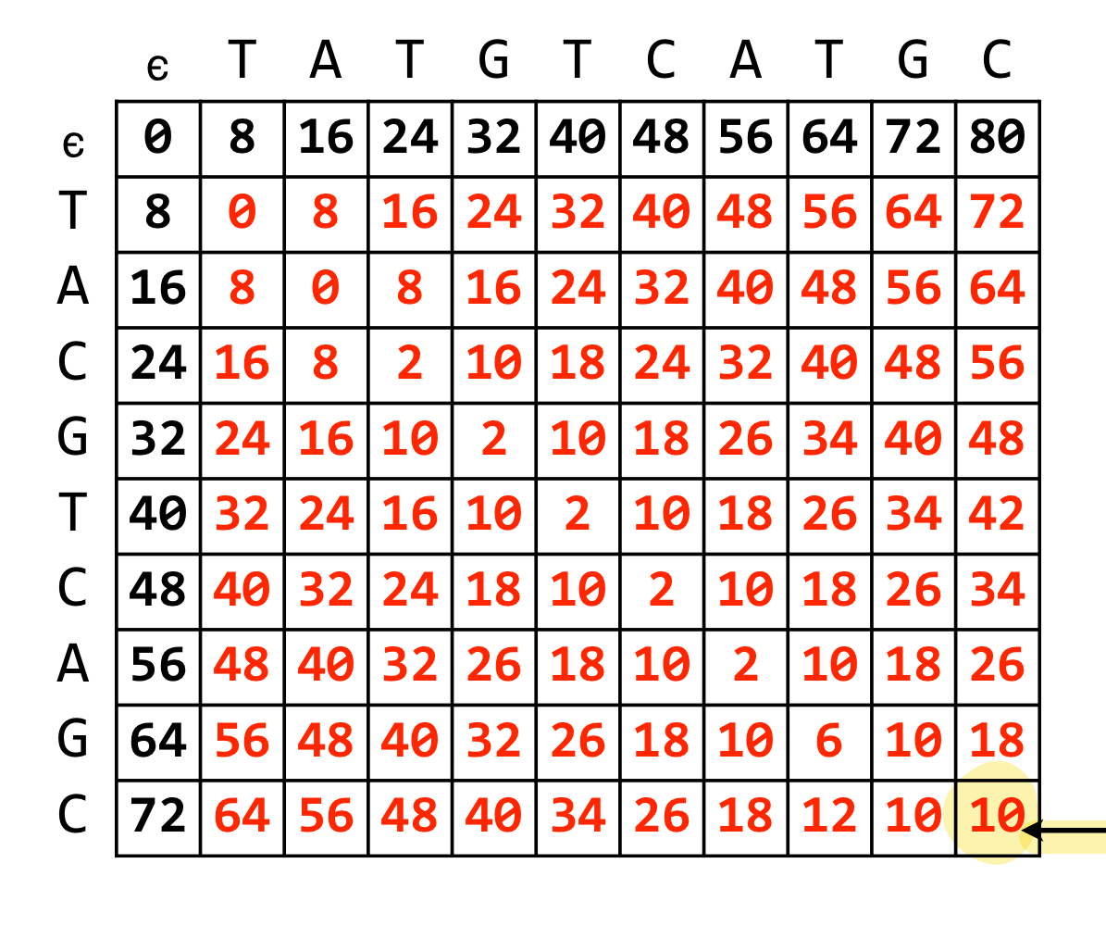
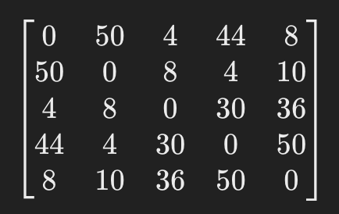
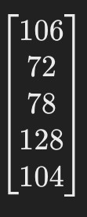
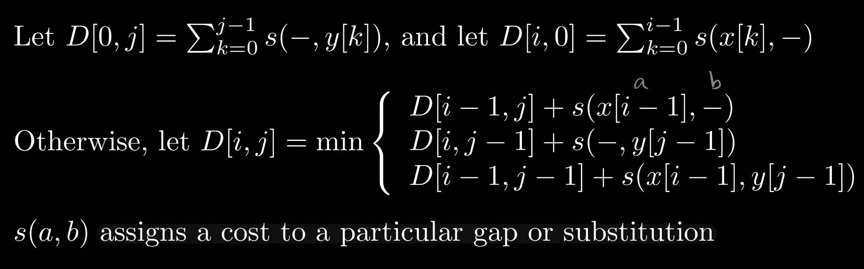
Methods: Decryption
2. Select Optimal Sequence: Pairwise Global Alignment
1. Repetitive Sequencing (Simulated)
GAACTGCG [2, 0, 1, 3]
↓
GAACTGCG [2, 0, 1, 3]
GAACTGCG [2, 0, 1, 3]
GAACGCG [2, 0, 1, 3] (deletion)
GAACTGCG [2, 0, 1, 3]
GAACTGAG [2, 0, 1, 3] (substitution)
Take Synthesized DNA
Sequencing 5 times
(0.01 for substitution, 0.005 for indels)
Penalty used:
2 for substitution, 8 for gaps(indels)
↓
GAACTGCG [2, 0, 1, 3] (optimal sequence)
3. Reverse Steps in Encryption
Notes:
To resolve this issue. We implemented 2 things.
Repetitive Sequencing. Sequence each dna 5 times, and then we choose the best one “least amount of error, closest to the ground truth”
To simulate situations where sequencing errors occur, we deliberately introduce substitutions errors. We set probability for substitution error to 0.01, and 0.005 for indels. (close to error rates in real-life sequencing technologies)
How do we chose the best one? Use Global alignment algorithm to do a pairwise global alignment:
Here’s the algorithm we implemented.
Bottom-up dynamic programming matrix: each pair of sequences, filling in global alignment value. As we do the alignment, we penalize mismatches. For substitution error, we penalize it by 2, for gaps (indels) we have a much bigger penalty of 8, bc much bigger impact.
2) For each pair in the 5 reads, evaluate global alignment value. We select optimal sequence by minimizing global alignment value.
3) Each of the 5 sequences will be aligned 4 times, select the optimal sequence that is the closest to other 4.
4) Now having the optimal sequence, plus the permutation key given to customer, can now reverse encryption steps

Slide 10

Results: A Quick Demo
30 random phone numbers
Notes:
Demo of running our program with 30 random phone numbers

Slide 11
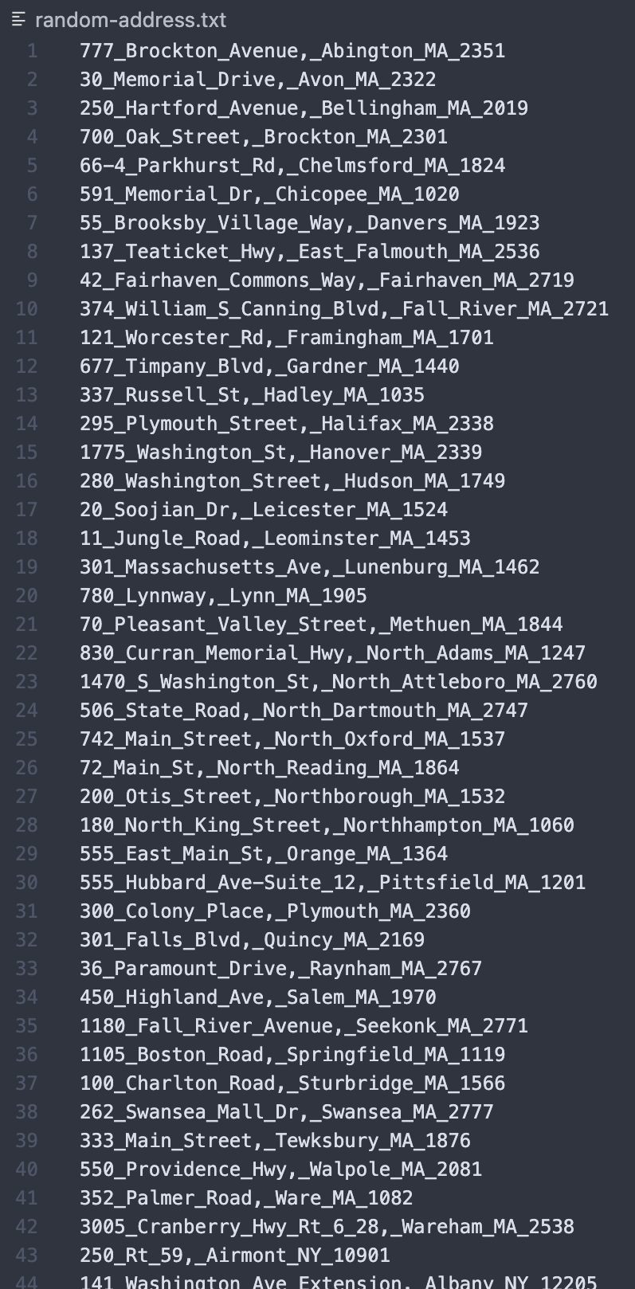
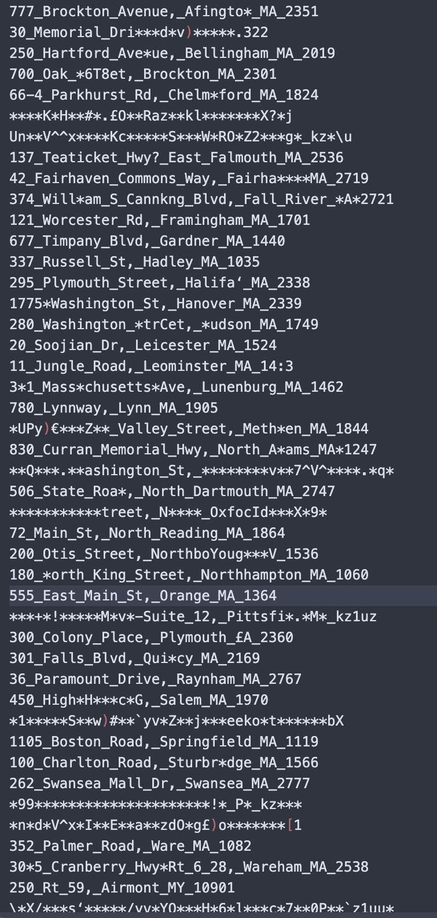
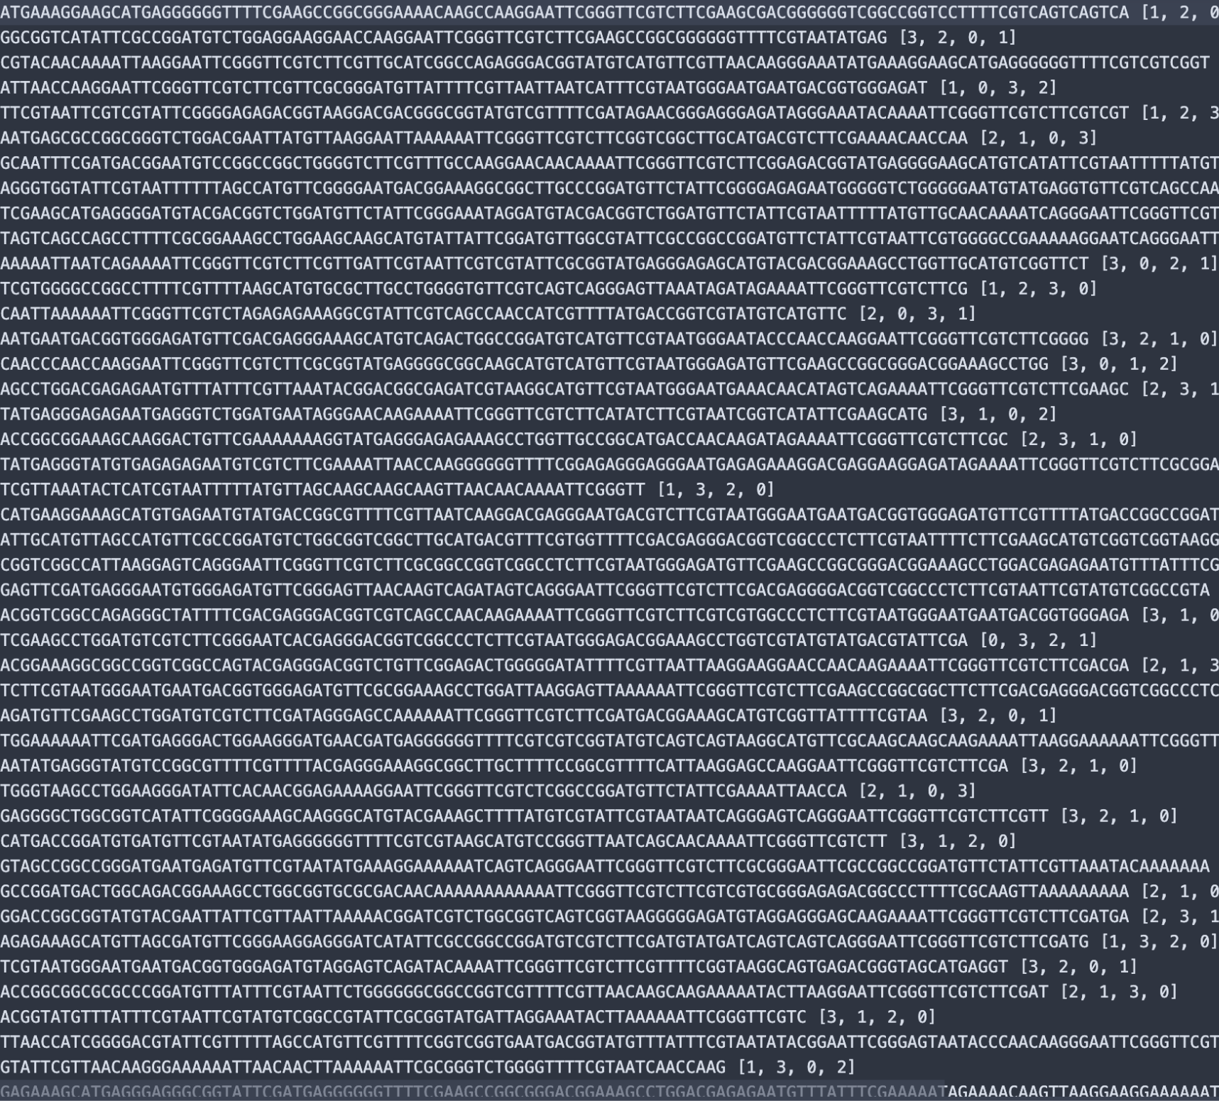
Results: 127 random addresses
Notes:
Pretty good. Most of the numbers are successfully restored.

Slide 12
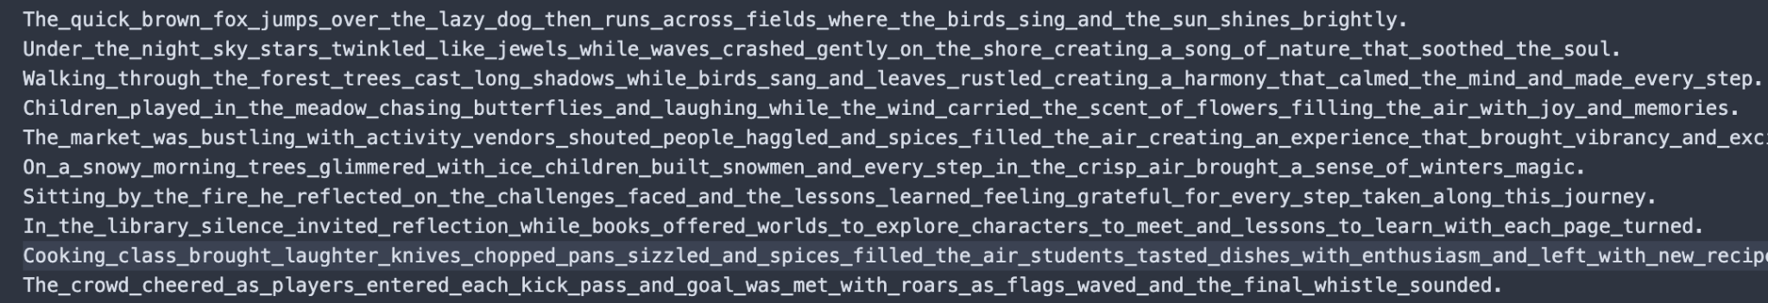
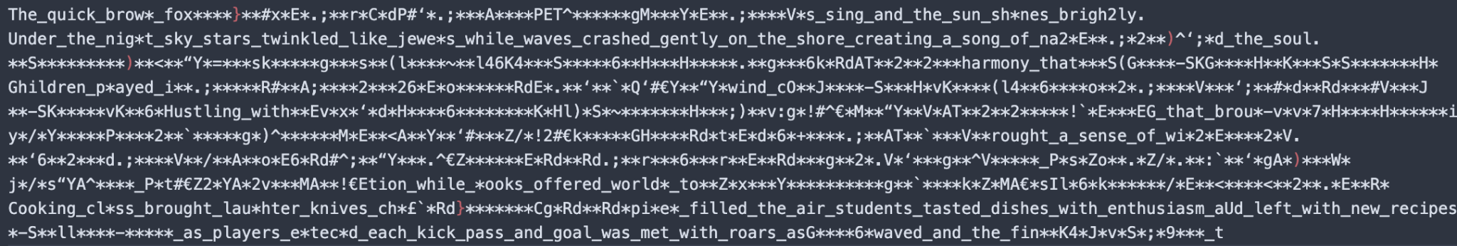
Results: 10 20-word paragraphs

Slide 13
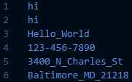
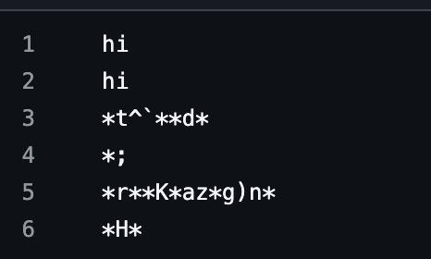
Discussions: Discarded Attempts
Burrows-Wheeler Transform
Using BWT for the final encryption, keeping the position of “$” as the key
Pros: space efficient, harder to decrypt without the key
Cons: sensitive to errors. Any indels can result in losing the entire sequence
$CAGTTTTACGGC ACGGC$CAGTTTT AGTTTTACGGC$C
C$CAGTTTTACGG
CAGTTTTACGGC$ CGGC$CAGTTTTA
GC$CAGTTTTACG
GGC$CAGTTTTAC GTTTTACGGC$CA
TACGGC$CAGTTT TTACGGC$CAGTT TTTACGGC$CAGT TTTTACGGC$CAG
CTCG$AGCATTTG
$’s position: key given to the customer

Slide 14
Discussions: Changes
Implemented Features | Future Changes
Implemented single-read end-to-end sequencing simulation | Consider adding assembler for sequencing fragments / fragmentize long messages.
Removed BWT to reduce decryption errors caused by indels | Sequence multiple times, use quality scores to select optimal bases
Attempted adding N to sequence (violated LF mapping) | Employ Bowtie2 for alignment to infer indel positions

Slide 15
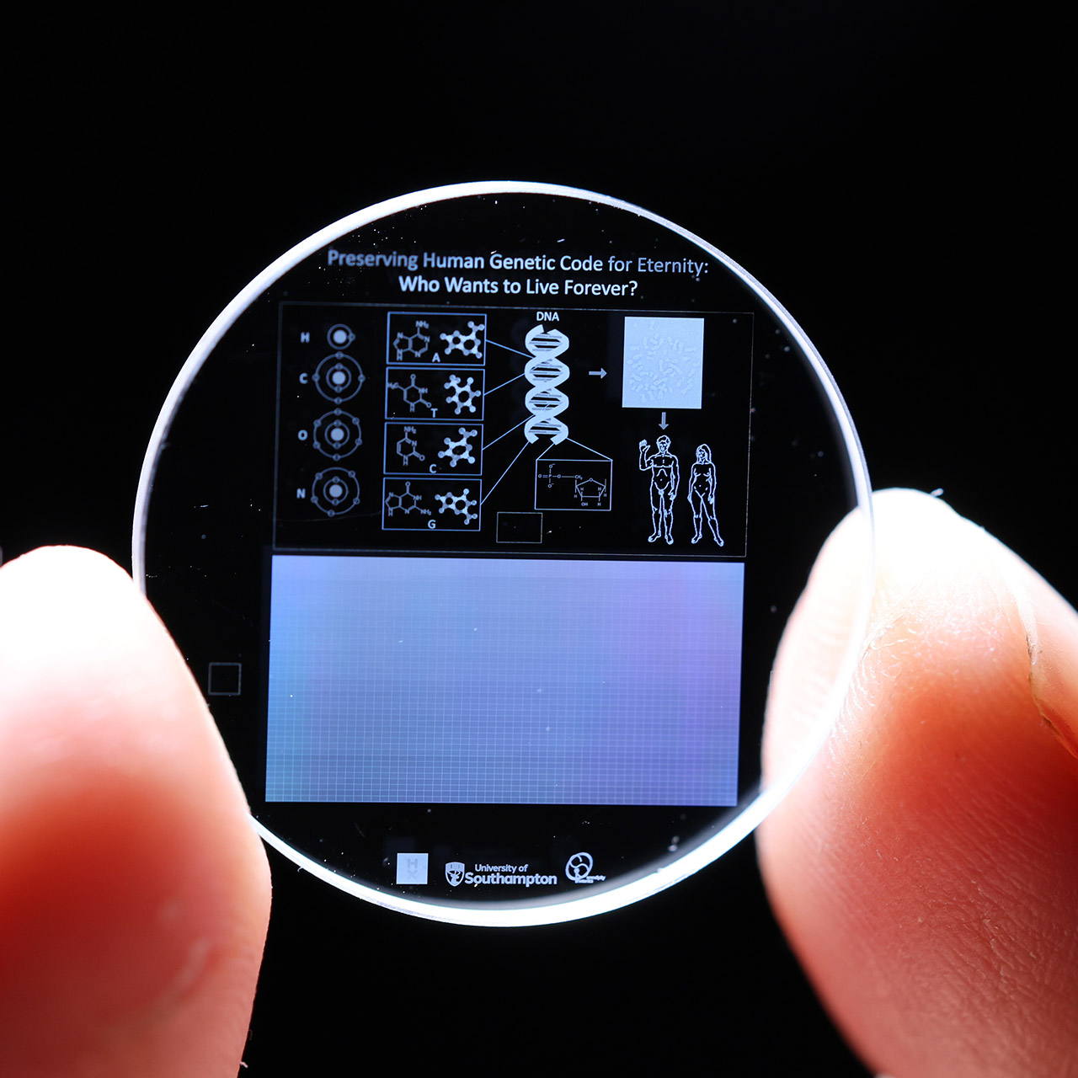
Discussions: Research Implications
DNA beyond bioinformatics to general information storage.
Tools and packages used for aligning or identifying patterns applicable to broader data storage and analysis scenarios
e.g. Bowtie2, SAMtools, jellyfish
Further User-based Encryption
Flexible permutation patterns: from random four-group permutations to user-defined configurations and becoming part of the key to decrypt the synthesized DNA.
Store information of databases
Establish full-scale genome to store Table-based structure
Query = sequencing specific chromosome

Slide 16
Acknowledgement
Questions?
Thank you to Dr. Michael Schatz and Matthew for this wonderful course!

